Slide 1
Introduction to Lean 4
Wang Yutong@NUS

Slide 2
Prove Theorem
Simple proof

Slide 3
Tactic proof
Over 300 different tactics in Mathlib
Simple: exact, rw, apply, rfl, calc …
Our target
Medium: simp, ring, group, field_simp, …
Advanced: linarith, norm_num, rify, omega…
Prove by calculation!
Super: aesop, ?, …

Slide 4
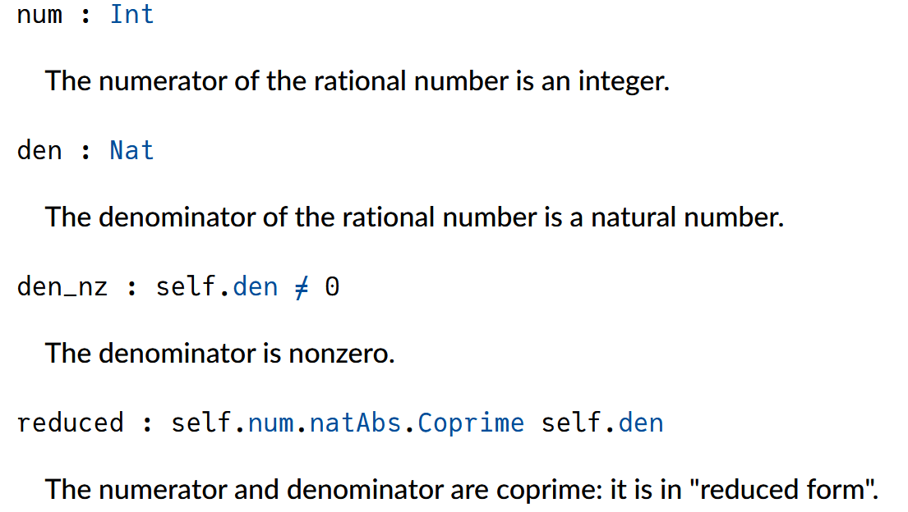
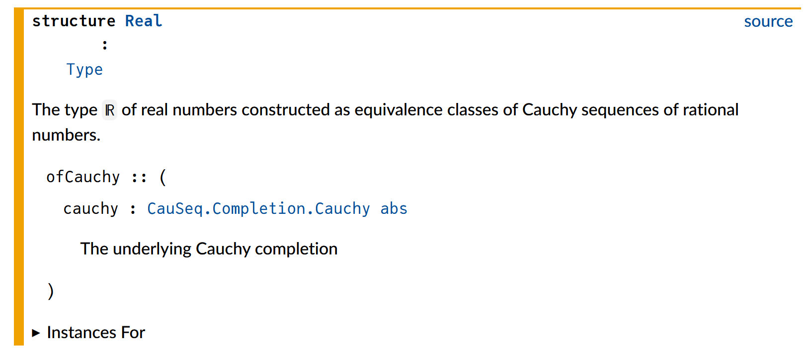
Fact about Real number
Axiomatization:
To define a theory by stating a set of primitive axioms
Rational number: r =(a, b)
a b are integers,
b ≠ 0,
a b are coprime
Real number:
equivalence classes of Cauchy sequences in rational numbers (Completion)

Slide 5
Fact about Real number
Group
(ℝ, 0, +)
Add Commutative Group:
(ℝ, 0, +)
Commutative Ring: r =(a, b)
(ℝ, 0, 1, +, *)
Group with Zero:
0^-1 = 0
a / 0 = a * 0^-1 = a * 0 = 0
Field:
(ℝ, 0, 1, +, *)
group
abel
ring
field_simp

Slide 6
Prove BY logic

Slide 7
some recent Tools
Search, translate and prove

Slide 8
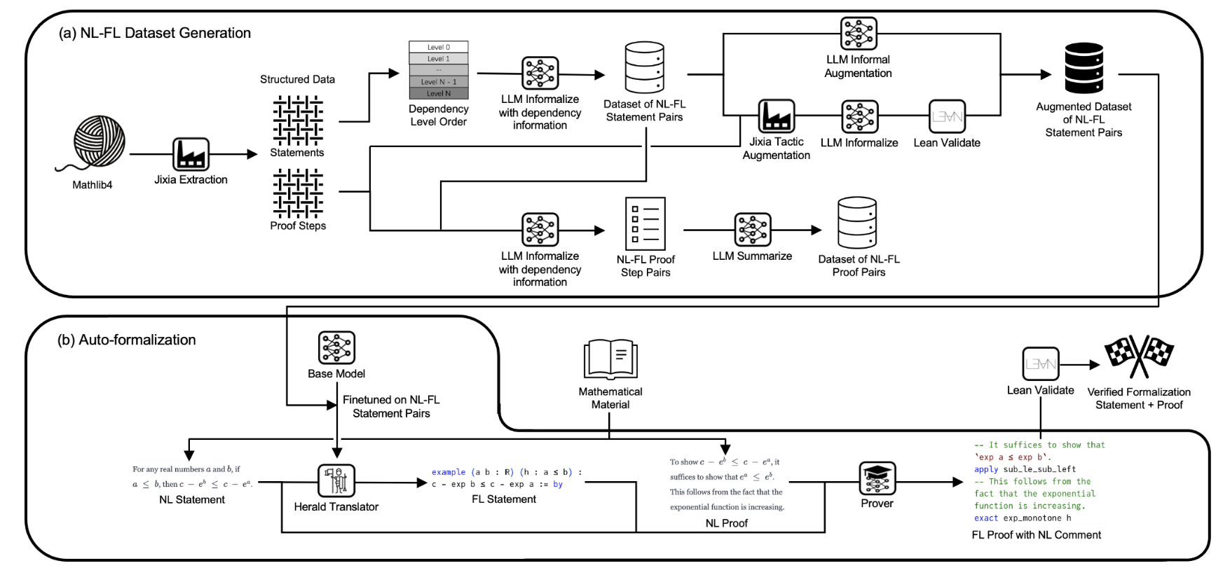
Lean translator

Slide 9
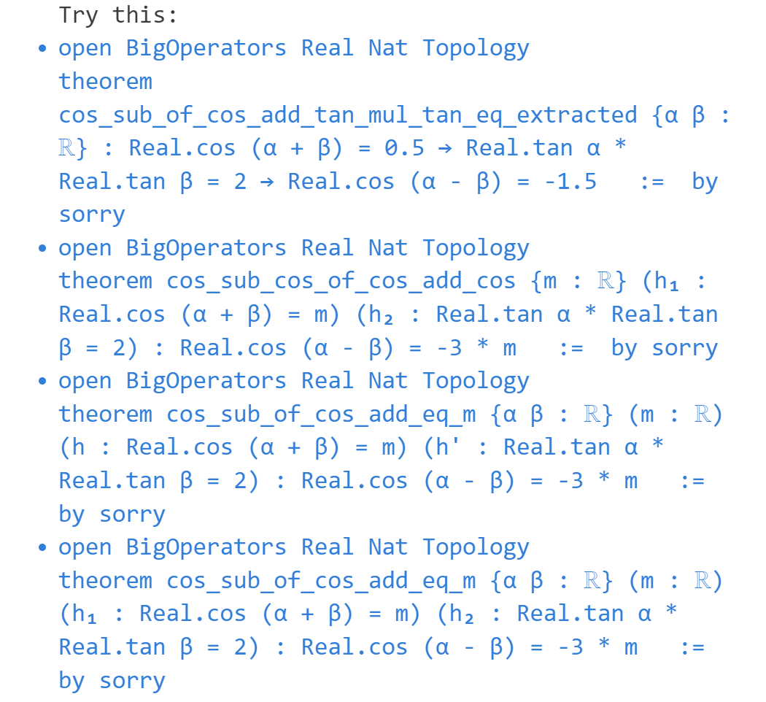
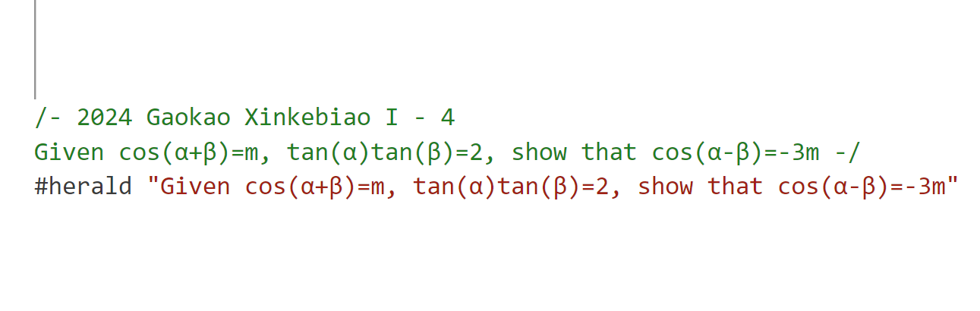
Lean translator

Slide 10
More links
References:
Mechanics of Proof: https://hrmacbeth.github.io/math2001/
Mathematics in Lean: https://leanprover-community.github.io/mathematics_in_lean/
Lean for Curious Mathematicians: https://github.com/lftcm2023/lftcm2023
Previous Episodes in NUS-Math-Formalization:
Calculus Game: https://github.com/NUS-Math-Formalization/CalculusSkeleton
Mathematics in Lean: https://github.com/NUS-Math-Formalization/coxeter
Tools Link:
Leansearch: https://arxiv.org/abs/2403.13310v1
Herald: https://arxiv.org/abs/2410.10878

